Slide 1





krce
Home
About Us
Service
Get in Touch
UPI Fraud Detector Using Machine Learning
By Mukil Subramani S G
Rollno:AM2329
Regno:8115U23AM029

Slide 2

krce
Home
About Us
Service
Get in Touch
Abstract
The increasing popularity of Unified Payments Interface (UPI) has led to a surge in digital transactions, making it an attractive target for fraud. This paper explores a machine learning-based solution for detecting UPI fraud in real time. By analyzing transaction data using various machine learning algorithms, the system can identify fraudulent activities and prevent financial losses. The proposed approach uses supervised and unsupervised learning techniques to classify transactions as either legitimate or suspicious, enabling prompt intervention.

Slide 3

krce
Home
About Us
Service
Get in Touch
Introduction
UPI Overview
Machine Learning Solution
UPI (Unified Payments Interface) is a real-time payment system developed by NPCI (National Payments Corporation of India) that enables instant money transfers between bank accounts.
Machine learning can analyze vast amounts of transaction data to detect unusual patterns or anomalies that signify fraudulent activities, offering a proactive approach to fraud prevention.
Fraud Challenges:
Customer
Despite UPI’s convenience, it has been increasingly targeted by fraudsters who exploit system vulnerabilities to commit fraud, affecting millions of users and causing financial losses.
It provide a easy to use for the UPIi with a hight security and provide a efficient way of transaction

Slide 4
krce
Home
About Us
Service
Get in Touch
Objective
Primary Objective: To develop a machine learning-based framework to detect and prevent fraudulent activities in UPI transactions.
Specific Goals:
To classify UPI transactions as legitimate or fraudulent using machine learning models.
To identify patterns in transaction data that indicate potential fraud.
To improve fraud detection accuracy with real-time decision-making.

Slide 5

krce
Home
About Us
Service
Get in Touch
Literature Survey
POPULAR MOBILE PAYMENT APPS
Data Integration Rule-based systems for fraud detection have limitations due to their rigid nature. Machine learning techniques, such as decision trees, random forests, and neural networks, have been explored for anomaly
Research Gaps: While some solutions exist, they often lack the adaptability and scalability needed to handle evolving fraudulent techniques in UPI systems.
Machine Learning in Financial Fraud Detection: Studies have shown that machine learning can adapt to new fraud patterns and increase detection accuracy over time..

Slide 6
krce
Home
About Us
Service
Get in Touch
Existing System:
Manual Detection Mechanisms: Fraud detection in current UPI systems often relies on manual intervention and rule-based methods, which can be slow and prone to errors.
Fraud Detection Systems: Some UPI platforms use basic pattern matching, but these systems often fail to recognize new or sophisticated fraudulent methods.

Slide 7
krce
Home
About Us
Service
Get in Touch
Proposed System:
Overview: A machine learning-based fraud detection system will analyze transaction data in real-time. The system uses supervised learning algorithms to classify transactions and unsupervised learning techniques to identify anomalies.
How It Works:
Collect transaction data (e.g., user profile, transaction amount, time, location, device information).
Preprocess and clean the data.
Apply machine learning models (e.g., logistic regression, decision trees, SVM, etc.) to detect fraud.
Flag suspicious transactions for review or automatic action

Slide 8
krce
Home
About Us
Service
Get in Touch
Limitations of Existing System:
Lack of Real-Time Detection: Existing systems cannot detect fraud in real time, leading to delayed intervention.
Limited Accuracy: Rule-based systems may not capture complex patterns of fraud.
Scalability Issues: Current solutions may struggle to scale with the increasing volume of UPI transactions.
Inability to Adapt to New Fraud Tactics: Fraudsters continuously evolve their methods, and existing systems cannot easily adapt

Slide 9
krce
Home
About Us
Service
Get in Touch
Advantages:
Real-Time Detection: Machine learning models provide instant fraud detection, reducing the risk of financial loss.
Improved Accuracy: Machine learning can adapt to new fraud patterns and improve over time.
Scalability: The system can handle large-scale UPI transactions, making it suitable for national and global applications.
Automation: Fraudulent activities can be automatically flagged, reducing the need for manual intervention

Slide 10
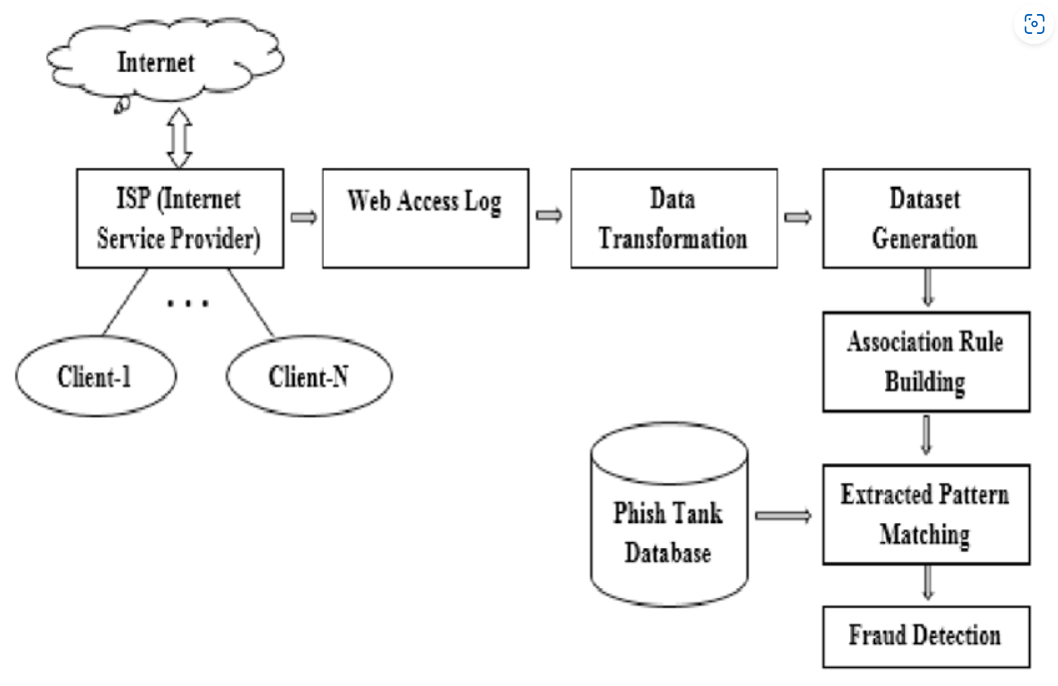
krce
Home
About Us
Service
Get in Touch
Systematic Architecture Diagram

Slide 11
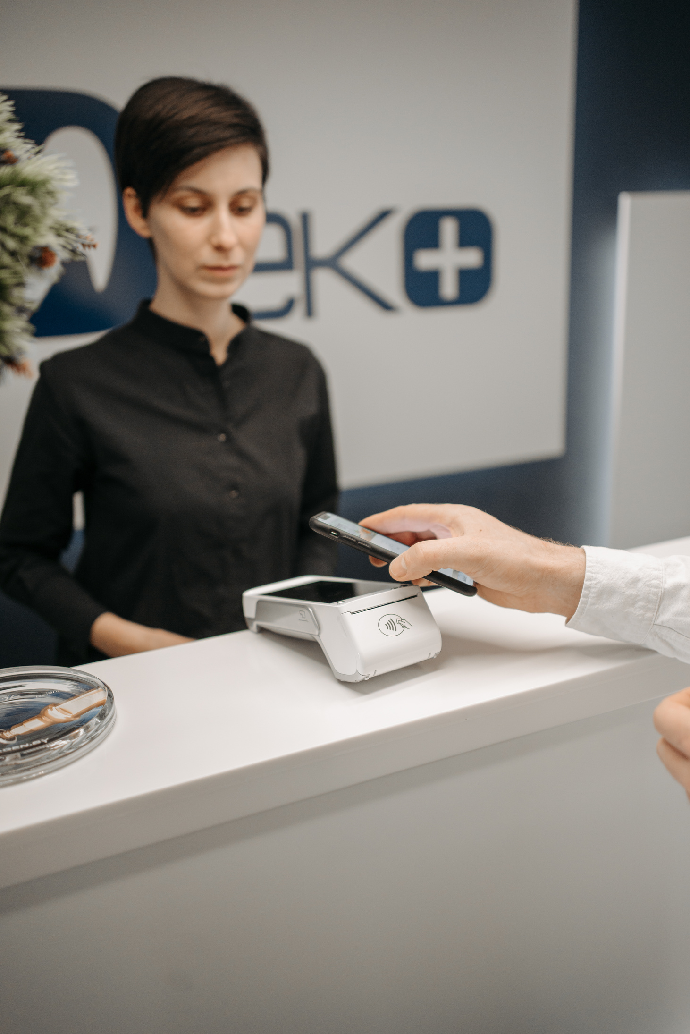
krce
Home
About Us
Service
Get in Touch
Modules
Model Training
Purpose: Train machine learning models on historical transaction data to identify fraud patterns.
Algorithms Implement models such as Decision Trees, Random Forest, Gradient Boosting Machines (GBM), and Neural Networks.
Fraud Detection
Purpose: Apply the trained model to real-time transaction data to flag potential fraud.
Tasks: Score transactions, detect anomalies, and classify transactions as legitimate or fraudulent.
Alert System
Purpose: Notify users and institutions when fraudulent activity is detected.
Methods: Automated alerts via SMS, email, or push notifications to prompt immediate action.

Slide 12
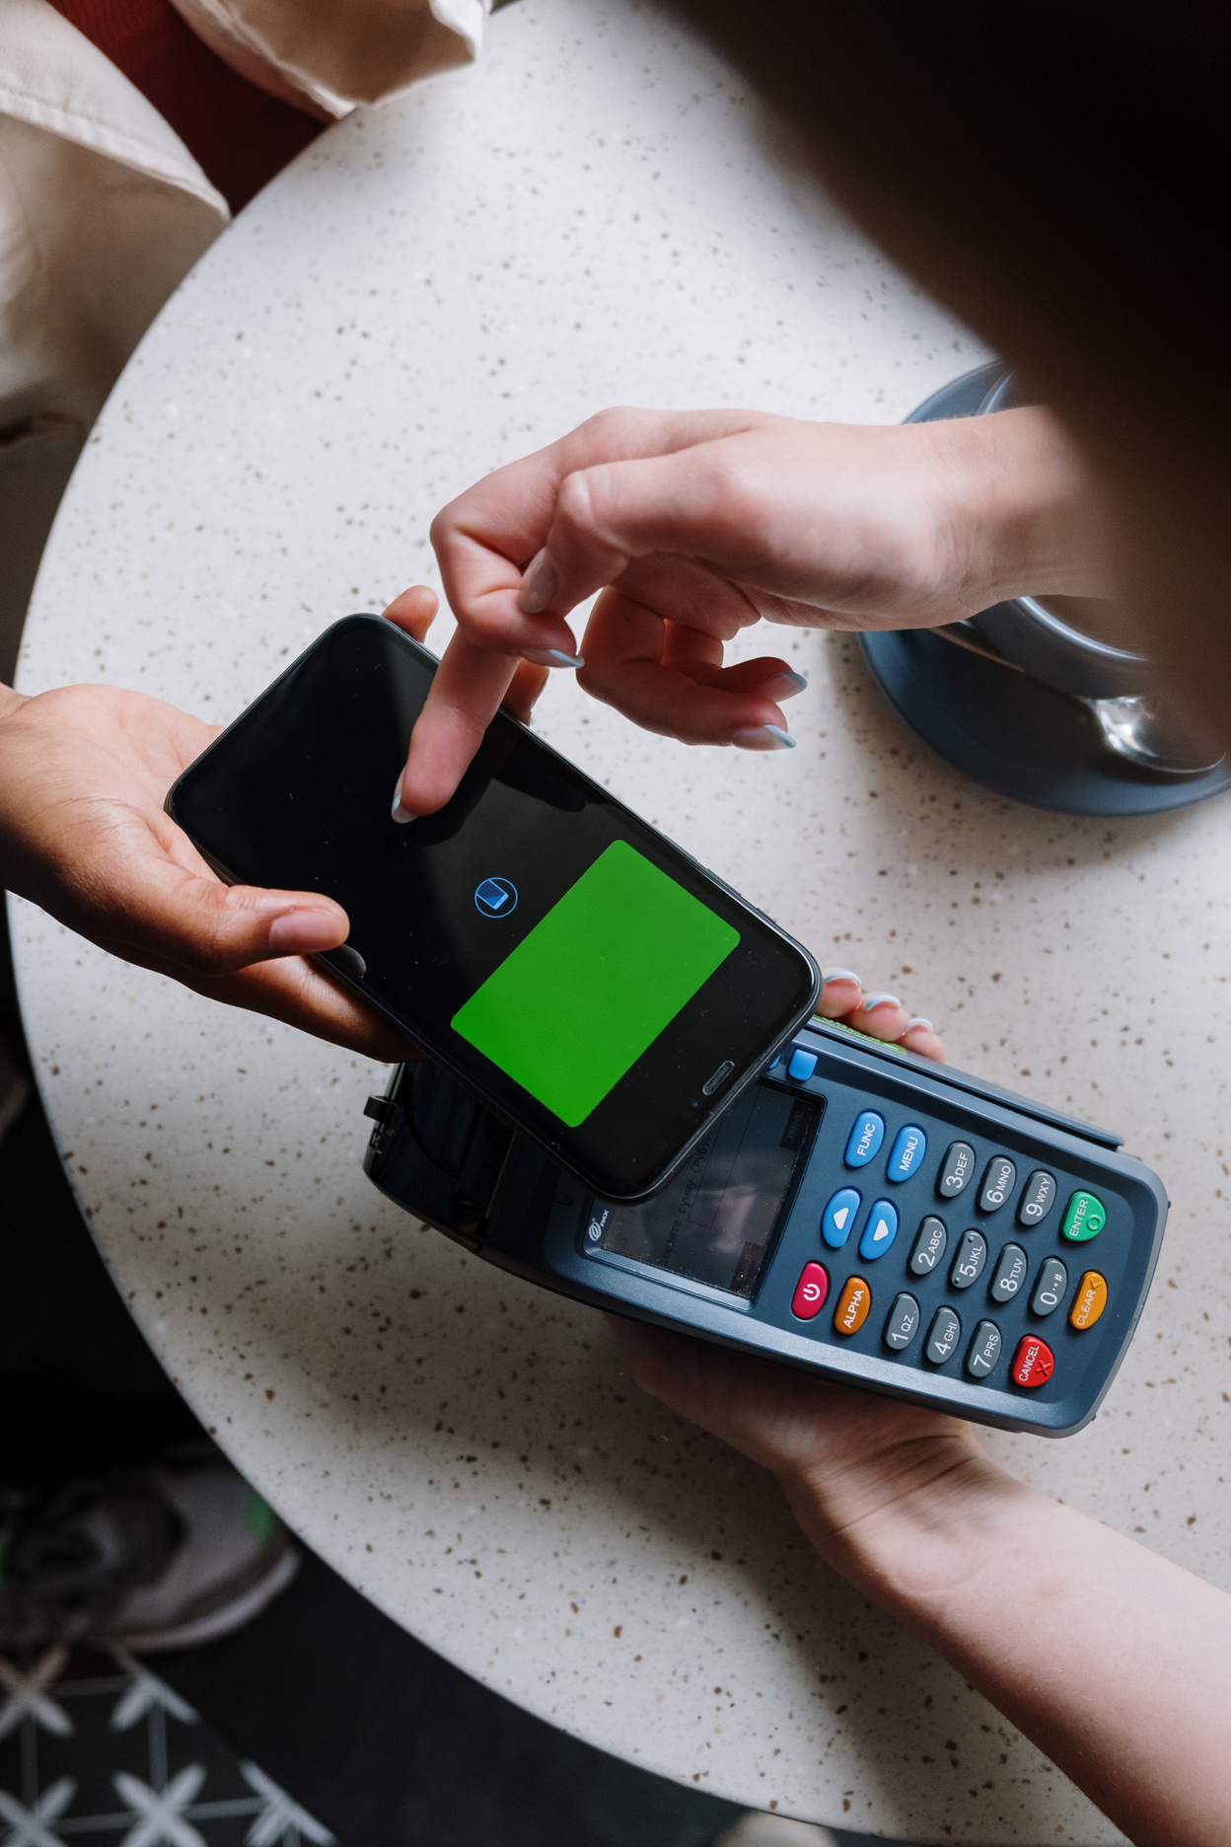
krce
Home
About Us
Service
Get in Touch
Modules Completion
SECURITY AND PRIVACY MEASURES
Model Training
Status: In Progress. We are currently training models and tuning hyperparameters.
Fraud Detection
Status: Testing Phase. Models are being tested with live data to evaluate performance.
Alert System
Status: Implementation Phase. Alerts are being integrated with the fraud detection system.

Slide 13


krce
Home
About Us
Service
Get in Touch
Modules Usage
Data Collection
Usage: Provides the raw data necessary for model training and evaluation. Essential for understanding transaction patterns and user behavior.
Model Training
Usage: Develops a predictive model that can identify fraud based on historical transaction data.
Fraud Detection
Usage: Analyzes new transactions to detect and flag potential fraud in real-time.
Alert System
Usage: Notifies relevant parties when fraudulent transactions are detected, allowing for prompt response.

Slide 14
krce
Home
About Us
Service
Get in Touch
Project Implementation
POPULAR MOBILE PAYMENT APPS
Data Integration Aggregate transaction data from multiple sources and integrate it into a unified database.
Model Development Build and train machine learning models using historical transaction data.
System Integration Embed the trained model into the UPI transaction processing system for real-time fraud detection.
Testing Evaluate the system’s performance using historical and live data to ensure accuracy and reliability.
Monitoring Continuously monitor system performance, adjust model parameters, and update with new data as necessary.

Slide 15
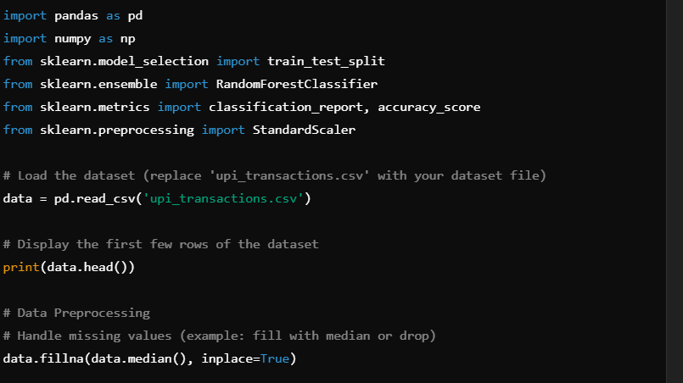
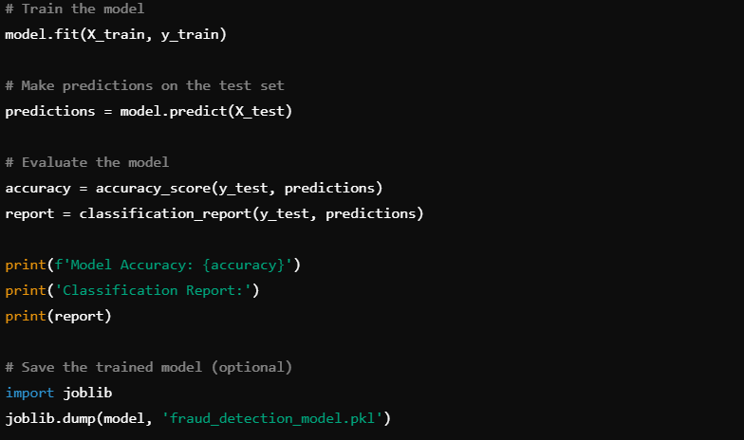
Program Implementation

Slide 16
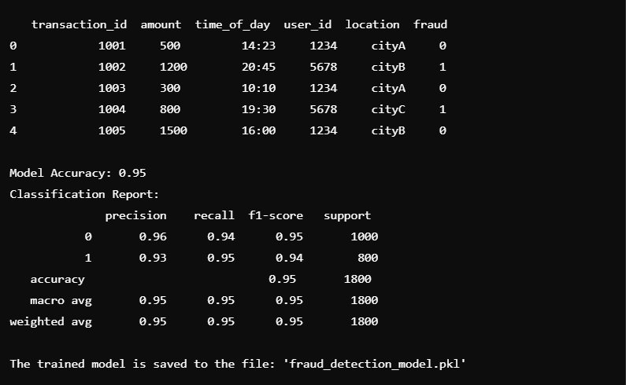
output

Slide 17
krce
Home
About Us
Service
Get in Touch
Conclusion
Summary
Future Work
Successfully developed a machine learning model to detect fraudulent UPI transactions, incorporating real-time fraud detection and alerting systems.
Explore advanced machine learning techniques and algorithms.
Expand the system to cover other types of financial transactions.
Integrate additional security features to enhance fraud prevention.
Achievements
Closing Remarks
Improved fraud detection accuracy and response times.
Enabled proactive security measures for UPI transactions.
Continuous improvement and adaptation are vital to staying ahead of evolving fraud tactics.

Slide 18
krce
Home
About Us
Service
Get in Touch
Future Enhancement:
Deep Learning Models: Incorporate deep learning algorithms for even more sophisticated fraud detection.
Integration with Multiple Platforms: Expand the system to work with other payment platforms (e.g., Paytm, Google Pay) in addition to UPI.
Adaptive Learning: Develop systems that continuously update models based on new fraud patterns and user behavior.
Blockchain Integration: Implement blockchain for transparent transaction tracking and fraud prevention.

Slide 19
krce
Home
About Us
Service
Get in Touch
References:
Author1, Author2, "Title of the paper/book," Journal Name, Year.
2.Author3, "Title of the research on fraud detection," Conference Name, Year.
3.XYZ, "Machine Learning in Financial Fraud Detection," Website Name, Year.

Slide 20
Thank You

